Slide 1

Case #1 Analysis
By: Craig Geter and George Garrelts

Slide 2
Introduction & Scope
Overview: Performed a Thorough Analysis for a Large Dataset consisting of over 185,000 rows of Problematic Sales Data
Purpose: Transform Cleaned Data into Meaningful Visualizations to Present Meaningful Sales and Performance Insights
Goal: To Leverage Analytical Insights to develop data-driven marketing strategies for further growth
Methodology: Utilized Python for Data Cleaning/Validation Processes
Primarily focusing on resolving all data inconsistencies first to ensure a reliable Analysis and Visualizations
Tableau for Insightful Visualizations

Slide 3
Data Overview
Sales Data #1 (185,000+ rows of raw data)
Electronic store (Newegg)
Source: Kaggle
Challenge: Ensure Data Integrity and Addressing Inconsistencies
Large Dataset requiring thorough Cleaning and Data validation
Tools Used: Python, Jupyter Notebook, and Tableau
Ensured Compliance with Terms of Use

Slide 4
Problem Statement
Central Problem: Understanding Sales Trends across various geographical regions
Focused Research on California – Top State for Sales Revenue
Identified Top Cities & Best Selling Products
Utilized Time Analysis
Analyzed Further Trends and Patterns
Data used to develop marketing strategies and improve Profitability and Revenue

Slide 5
Data cleaning
Importance of Data Integrity
Steps:
Revised Column Names for Enhanced Comprehension (e.g., 'Product_ean' to 'product_id'.)
Recategorization of product values from invalid French categories to English
Split 'Purchase_Address' column for enhanced geograpical analysis
Checked for any Null Values to ensure Data Integrity
Converted Columns to appropriate data types

Slide 6
Data validation
Reinforcing data integrity
Steps:
Finding & Removing any duplicate rows to eliminate redundant data
Reviewed calculated columns for any inconsistencies (eg. 'revenue' and 'profit_margin'
Addressing 'floating-point-rounding-error'
Identifying and Understanding outliers using statistical summary
Exporting revised cleaned data
Fixed by Incorporating a smaller margin of error (tolerance) of 1e-6 to ensure better calculation accuracy
Calculation Error that Computers with inadequate make when dealing with Big Data and Large Numbers

Slide 7
Analysis & Visualization
Choice of Tableau for scalability and interactivity
Visualization baseline
Insights: California as top earner, top cities, and product diversity

Slide 8
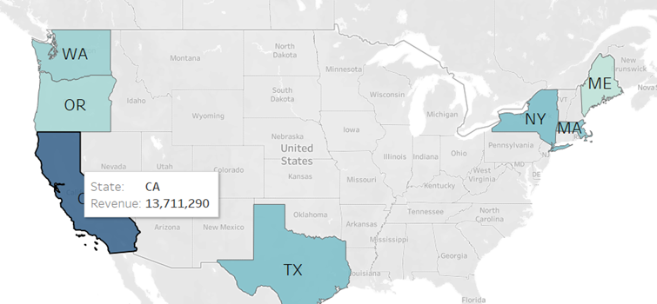
TOP REVENUE STATES SALES MAP: GEOGRAPHIC INSIGHTS INTO SALES PERFORMANCE (2019)

Slide 9
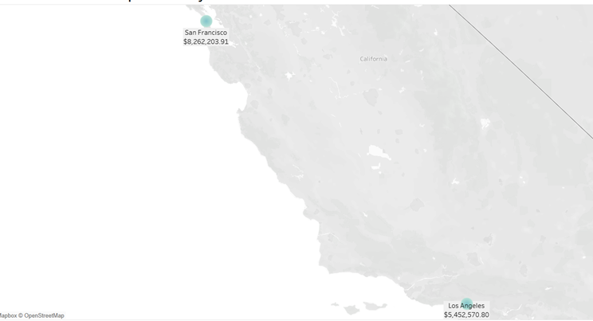
Revenue profiles: Comparative Study

Slide 10
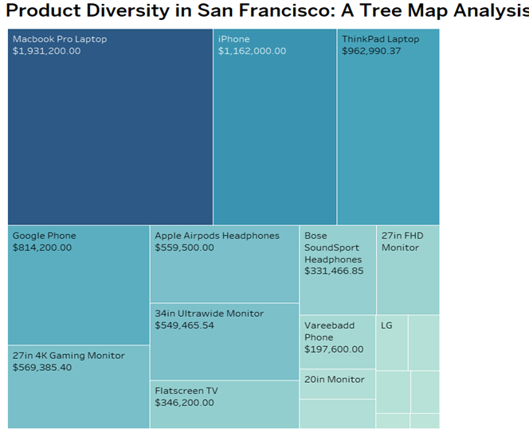
Tree Map: Product Diversity in San Francisco

Slide 11
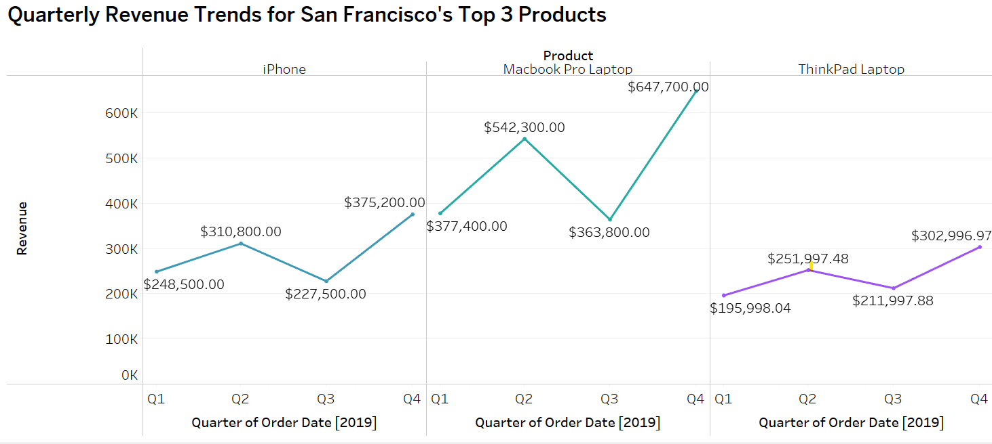

Slide 12
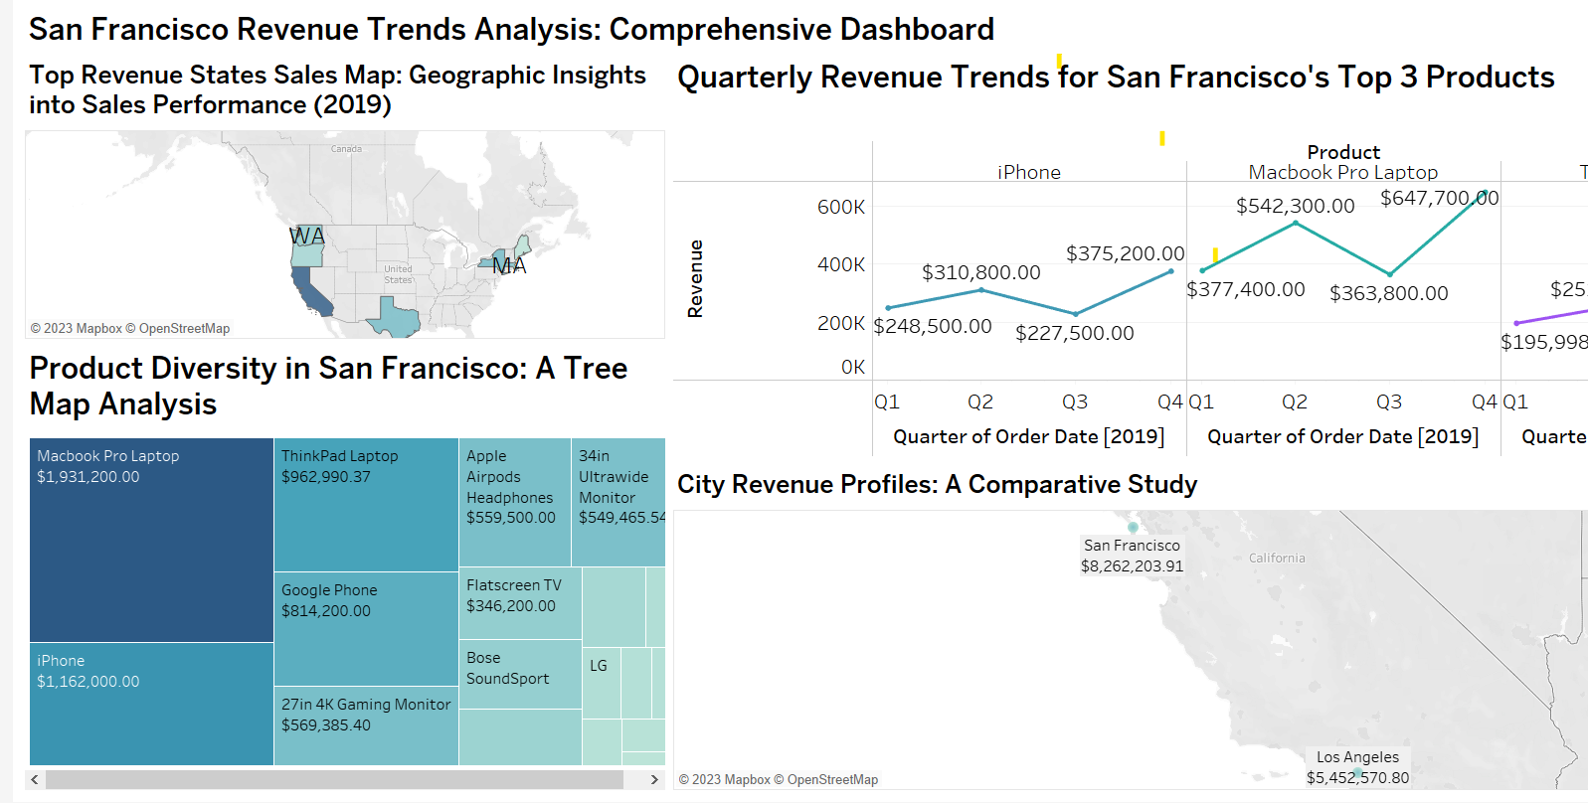

Slide 13
Insights & Recommendations
Focus on San Francisco: Top products- iPhone, Mac Book Laptop, and Think Pad
Seasonality and marketing correlation
Promotional tactics

Slide 14
Considerations
2020 Data Excluded due to abnormal consumer behavior patterns and other conditions caused by the Global Pandemic
Ensures Analysis reflects normal sales trends not inflicted by the atypical pandemic related events of 2020
Results in more accurate analysis of trends and planning for Post-Pandemic market conditions

